Slide 1






The Company
Leading The Future...!!
www.xcelcorp.com, https://nyinst.com, www.orena.solutons

Slide 2
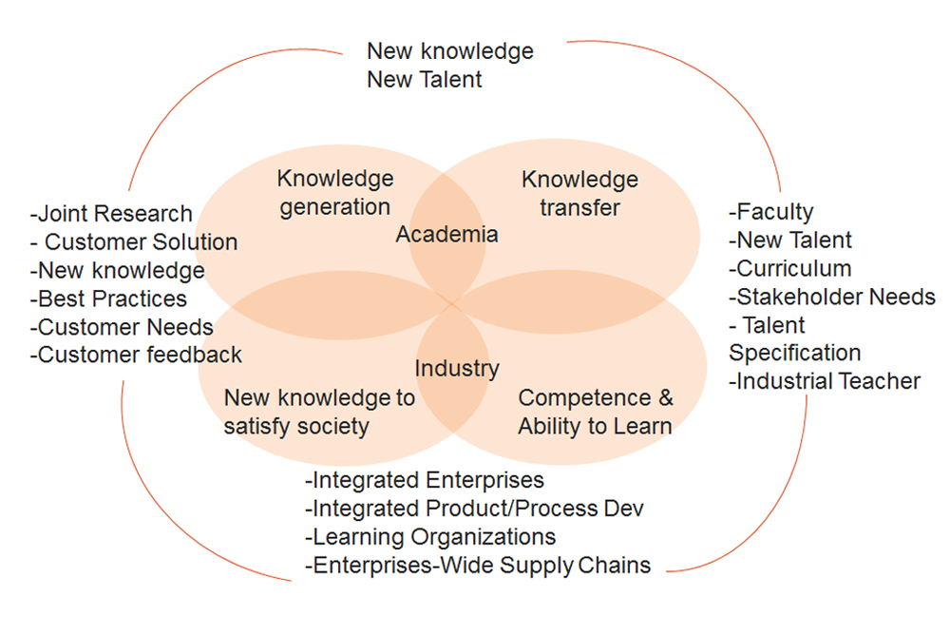

Our Vision
Our vision is to create an ecosystem to equip, empower and encourage the Human Talent for companies to contribute towards their growth through finding right talent and developing specific, customized and relevant research based training & mentoring programs using Technology+.

Slide 3




Our core values
Embracing Challenges
Ethics and Dignity
Diversity
Maintaining Quality

Slide 4
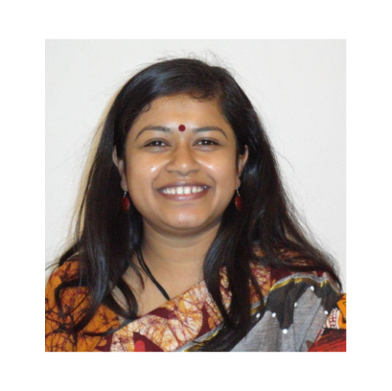
Meet The Directors
Ekata Mehul
Principle Director
Ekata Mehul, Director and CEO – Blazing Arrows Pvt. Ltd.; 25 years of experience in Industry & Academia; Board of Studies for various Universities; Ph. D. (Wireless Sensor Networks) (Education); M. Tech (ICT). B. Tech. (Comp.). Patent – “digital metering using Zigbee Technology’”, chapters in Books, Papers Publications. Nominated as “Women Entrepreneur Gujarat by GESIA”; IVLP Alumni in US for ‘Women in Technology”; “Traveler” for Arkansas state, US. Subject Matter Expert and Master Trainer – ESSCI, SSC NASSCOM. Executive member for “Computer Society of India, Baroda Chapter”, Core Committee in Vadodara HR Forum, life member for NASSCOM, ISTE, IETE. Director for “Women in Big Data, India”. An Educator & Blissful Human being
  25+ years of industry experience as a Chief Software Architect
  B.Tech (Computer Science, 1995), NIT Rourkela
  Industry Academia Anchor, KDEM, Govt of Karnataka, India
  Executive MBA - Harvard Business School
  AI/Data Science & Quantum Computing - MIT, Boston
  Past President - NIT Rourkela Global Alumni Association
  Prior Industry Experience: IBM USA, AT&T NJ, CNR Corp, eVue etc.
  Serial Entrepreneurship & Mentor for Startups and Angel Investor
  Active Participant in various standardizing organizations
  Acting as a Board Member for various companies
  Visionary and catalyst for Industry-Academia collaboration
  Instrumental in setting up COE and Incubation Centers

Slide 5
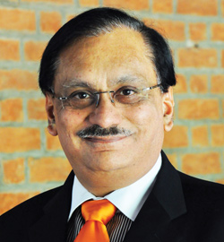
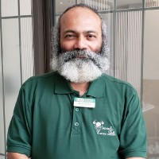

Advisory Board Members
Dr. Bhuvan Unhelkar
Dr. Prabhat Ranjan
Mr. Pratul Shroff
Professor of Information Technology; Consultant
Sarasota, Florida
Vice Chancellor at D Y Patil International University, Akurdi, Pune
Former – Director, TIFAC
Philanthropist, Thinker & Doer!!
Former – Founder of eInfochips
Current – Founder for Dr. K. R. Shroff Foundation

Slide 6

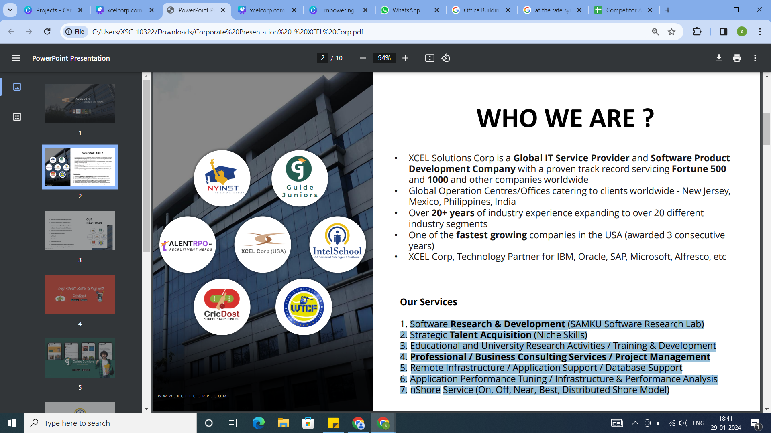





WHO WE ARE
  XCEL Solutions Corp is a Global Enterprise Solution Provider, a leader in Digital Transformation and Product Development Company with a proven track record servicing Fortune 500 and 1000 and other companies worldwide.
  Global Operation Centres / Offices catering to clients worldwide - New Jersey, Mexico, Philippines, India.
  Over 20+ years of industry experience expanding to over 20 different industry segments.
  One of the fastest growing companies in the USA (awarded 3 consecutive years).
  XCEL Corp, Technology Partner for IBM, Oracle, SAP, Microsoft, Qlik, AWS, etc.
OUR SERVICES
1. Software Research & Development (SAMKU Software Research Lab)
2. Strategic Talent Acquisition (Niche Skills)
3. Educational and University Research Activities / Training & Development
4. Professional / Business Consulting Services / Project Management
5. Remote Infrastructure / Application Support / Database Support
6. Application Performance Tuning / Infrastructure & Performance Analysis
7. nShore Service (On, Off, Near, Best, Distributed Shore Model)

Slide 7
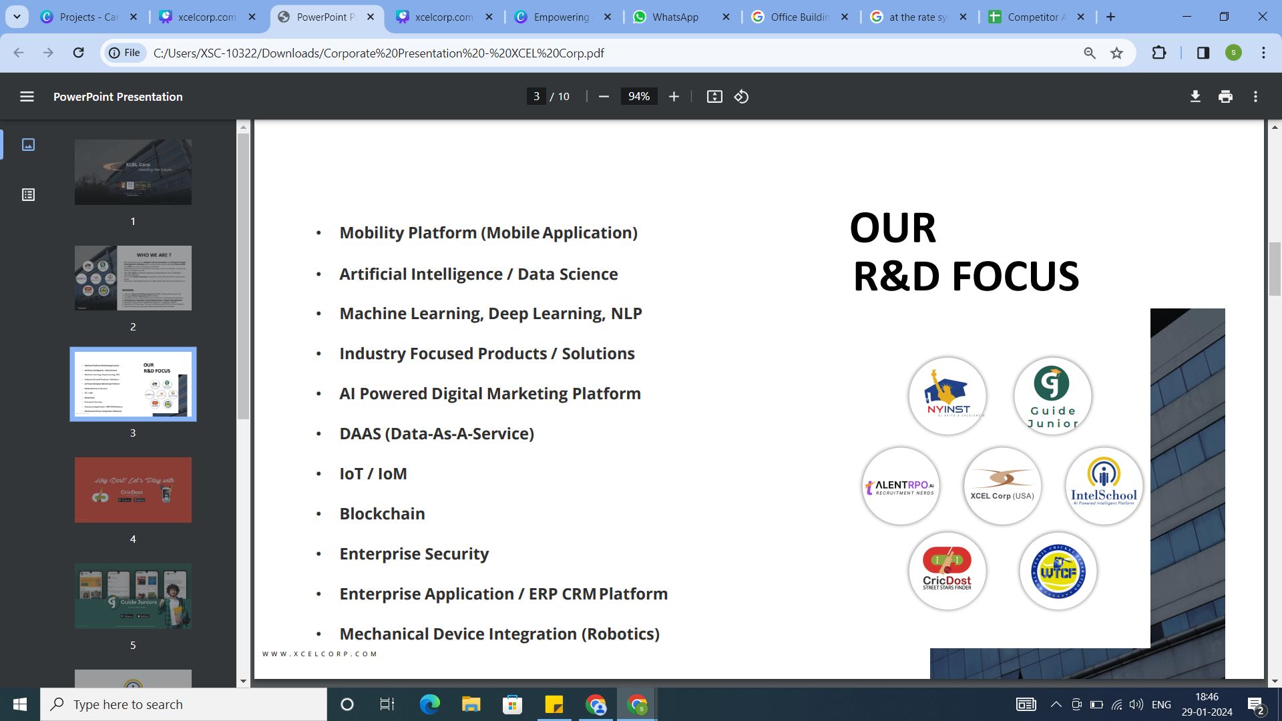

OUR R & D FOCUS
  Mobility Platform (Mobile Application)
  Artificial Intelligence / Data Science
  Machine Learning, Deep Learning, LLM, GenAI
  Industry Focused Products / Solutions
  AI Powered Digital Marketing Platform
  DAAS (Data-As-A-Service) • IoT / IoM
  Blockchain
  Quantum Computing
  Enterprise Security
  Enterprise Application / ERP CRM Platform
  Mechanical Device Integration (Robotics)

Slide 8







Domains
Automation
Embedded Systems
Digitalization
IT & ITES
Industry 4.0
Consumable Durables
E-Commerce

Slide 9






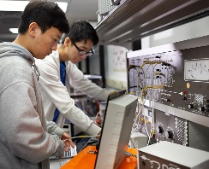
Our Services – Apart from Products
Making Industry Ready
Talent Acquisition
Expert Exchange
Corporate Workshop
IP Patent & Development
Setting up
Research Centers
Executing Industrial
Projects

Slide 10



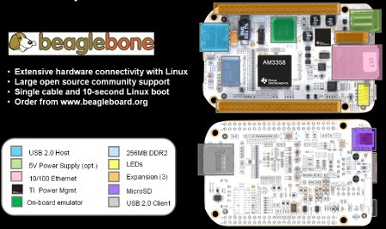



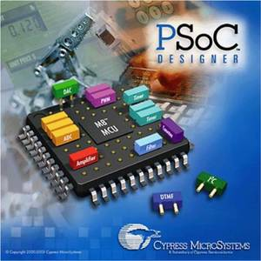


Research Labs

Slide 11
OUR SUCCESS STORIES
  Largest Implementation of Pre-paid Mobile Recharging Platform (VTAE), Telcel (American Movil), Mexico. 200+ team size (platform generated more than 2 Billion USD in revenue)
  Biggest SAP Implementation Partner in the USA and Asia Market
  Implemented large enterprise applications for clients: SAP, Oracle, SalesForce, etc.
  VAR/OEM partner for SAP, Oracle, F5, Pentaho, Open Source Technologies
  Implemented GIS platform for Sinaloa State Government (Land Management)
  Implemented Subscription Management System (largest media company)
  IT Staffing and Talent Acquisition partner for Fortune 500 clients
  Provided Enterprise Software Solutions to large, medium, and small clients (application development, project management, cloud technologies, etc.)
  Industry Recognitions (in USA): Inc 500 (multiple times), Best Places to Work In NJ (multiple times), Mr. Goel was recognized as “Forty Under Forty”, Deloitte Fast 50, NJ Biz Fastest Growing Company, etc.

Slide 12
Past Experiences
1
IP Patent
1500 Engineers
Trained
98%
Placement
20
Intellectual Properties
3
Entrepreneurs.

Slide 13



Product development (IT and Embedded)
The creation of products with new or different characteristics that offer new or additional benefits to the customer.
Product development may involve modification of an existing product or its presentation, or formulation of an entirely new product that satisfies a newly defined customer want or market niche.
Chronica
ezGeoCapture
ezNetScan
HRMS
eLearning
ERP

Slide 14
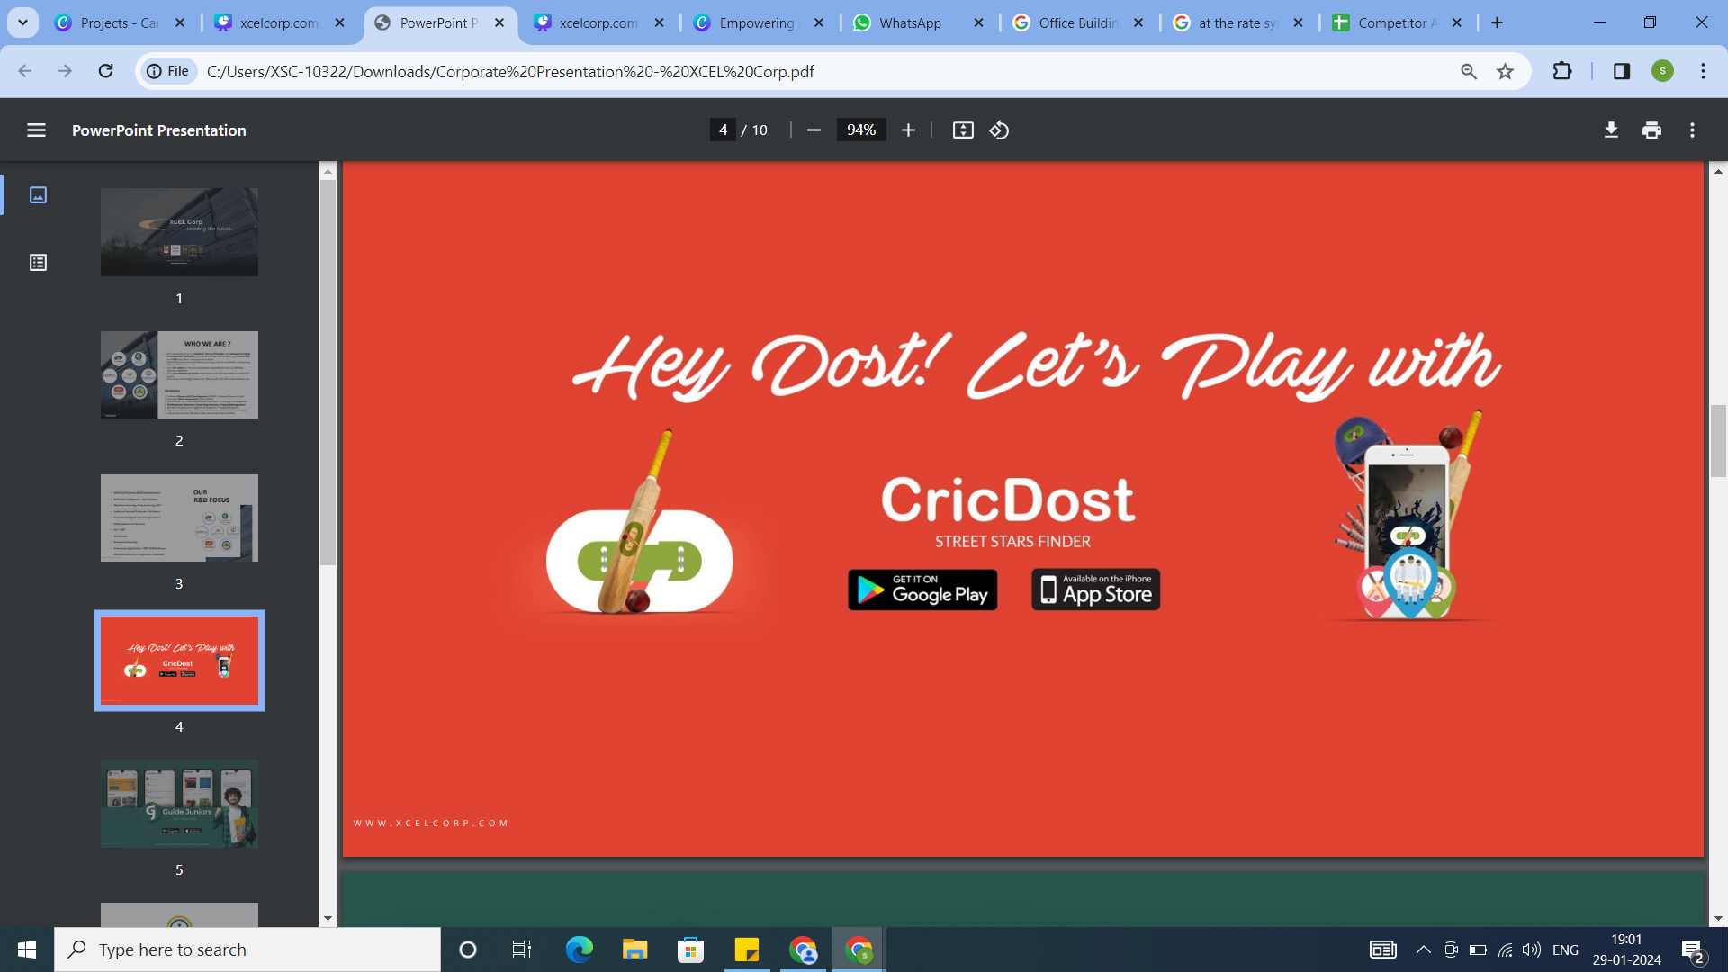

Slide 15
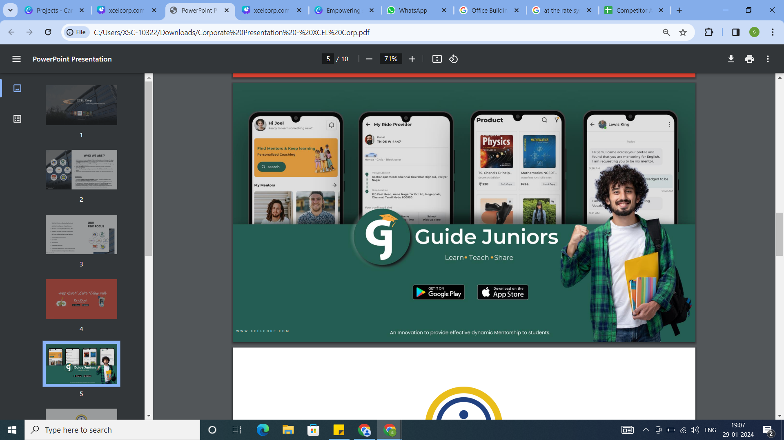

Slide 16

  Intel School is a STATE-OF-THE-ART solution platform built to enable schools to provide, manage and monitor the entire operations of an educational institution in the most efficient way.
  It is extremely flexible, customizable and can be precisely tailored to meet the requirements for our customers .
  We offer highly-upgraded versions of the software, equipped with the latest technology and solutions to give the best to our customers to stay ahead of competition.

Slide 17






Industry Recognition

Slide 18






Universities partners

Slide 19
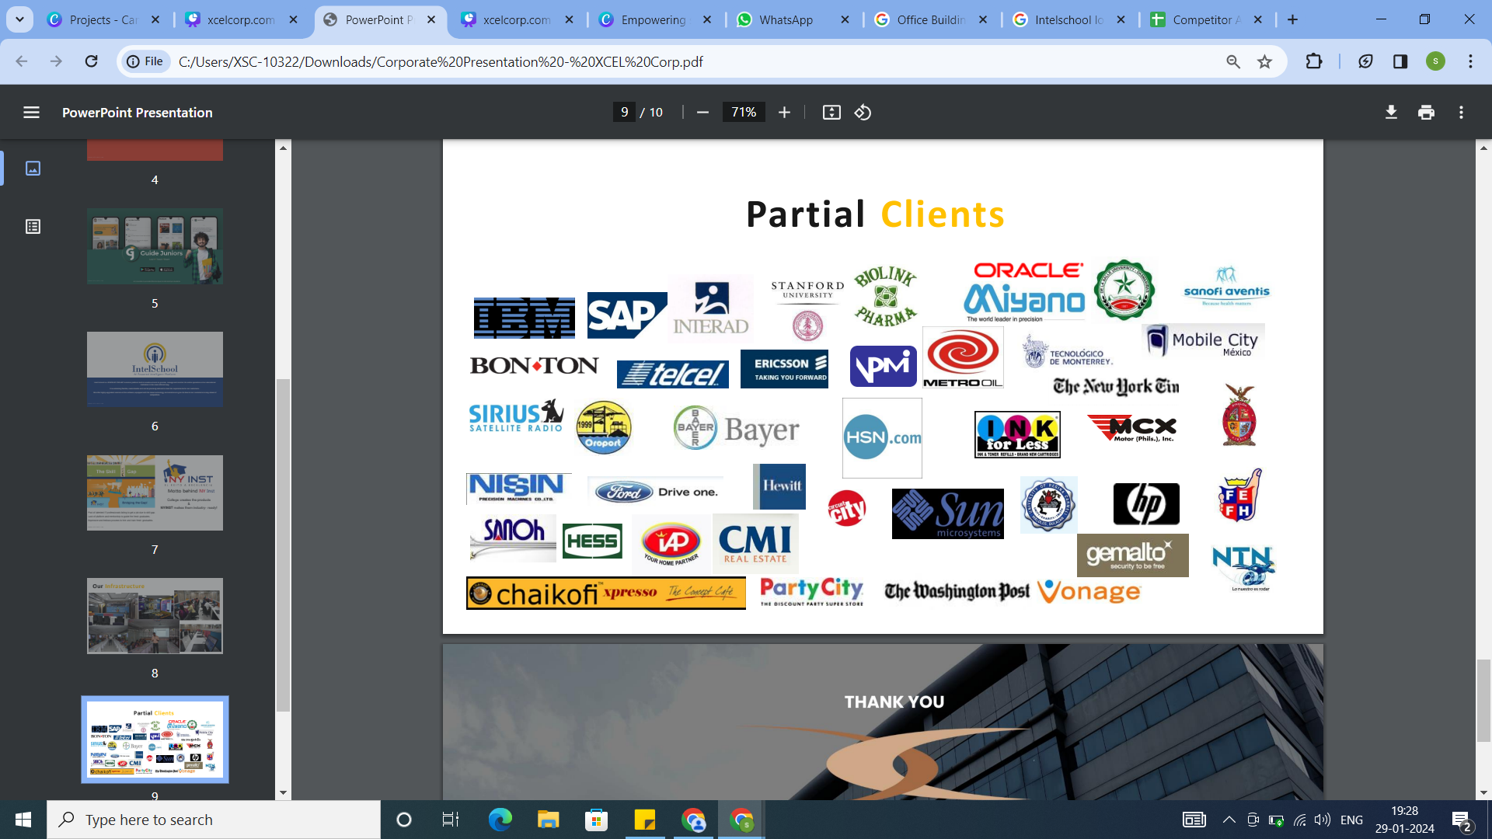
OUR PARTIAL CLIENT

Slide 20





















Success Story & Clients

Slide 21











Success Story & Clients

Slide 22

Reach us at-
www.orena.solutions
+91 98243 47721

Slide 23



Follow Us
LinkedIn
Instagram
Facebook
Orena Solutions Pvt. Ltd. (Admin Page)
Orena Foreign Collaboration
Orena Solutions Pvt. Ltd.
Orena Solutions (Business Page)
Orena Product Selling
Orena Foreign Collaboration
Orena Solutions Pvt. Ltd. Development
Orena Solutions Pvt. Ltd
Orena Solutions Product Selling
Orena Development
Orena Solutions Development
Orena Foreign Collaboration
LinkedIn Product Selling

Slide 24
THANK YOU.

